Slide 1


Analysis of smoking status impact on molecular mechanisms of SARS-CoV-2 viral entry through single-cell sequencing experiments
Author: Mateusz Urbanek
Supervisor: PhD Anna Papież
Notes:
Note: After adding your pictures, right click on it and “Send To Back”.

Slide 2
03 - Workflow
Data loading
Helper function for loading type agnostic files – works with CSV, TSV, and HDF5 files
Calculating number of expressed genes and building a histogram out of the data

Slide 3
03 - Workflow
QC metrics
Calculate number of Mitochondrial and Ribosomal RNA for each cell
Plotting histogram of both metrics

Slide 4
03 - Workflow
QC metrics
Plot number of molecules detected per cell (nCounts_RNA), number of genes detected per cell (nFeatures_RNA) and other metrics as violin plot to visualize distribution between datasets.
Calculate additional QC metrices for nFeatures_RNA and nCounts_RNA
Min
Max
Median
Standard Deviation
95th quantile

Slide 5
03 - Workflow
QC metrics
Plot feature scatters to visualize cut-off areas:
Delete all cells with more than 5% of ribosomal and mitochondrial RNA
Delete cells with less than 500 genes detected per cell
Delete cells with more than 95th quantile of molecules

Slide 6
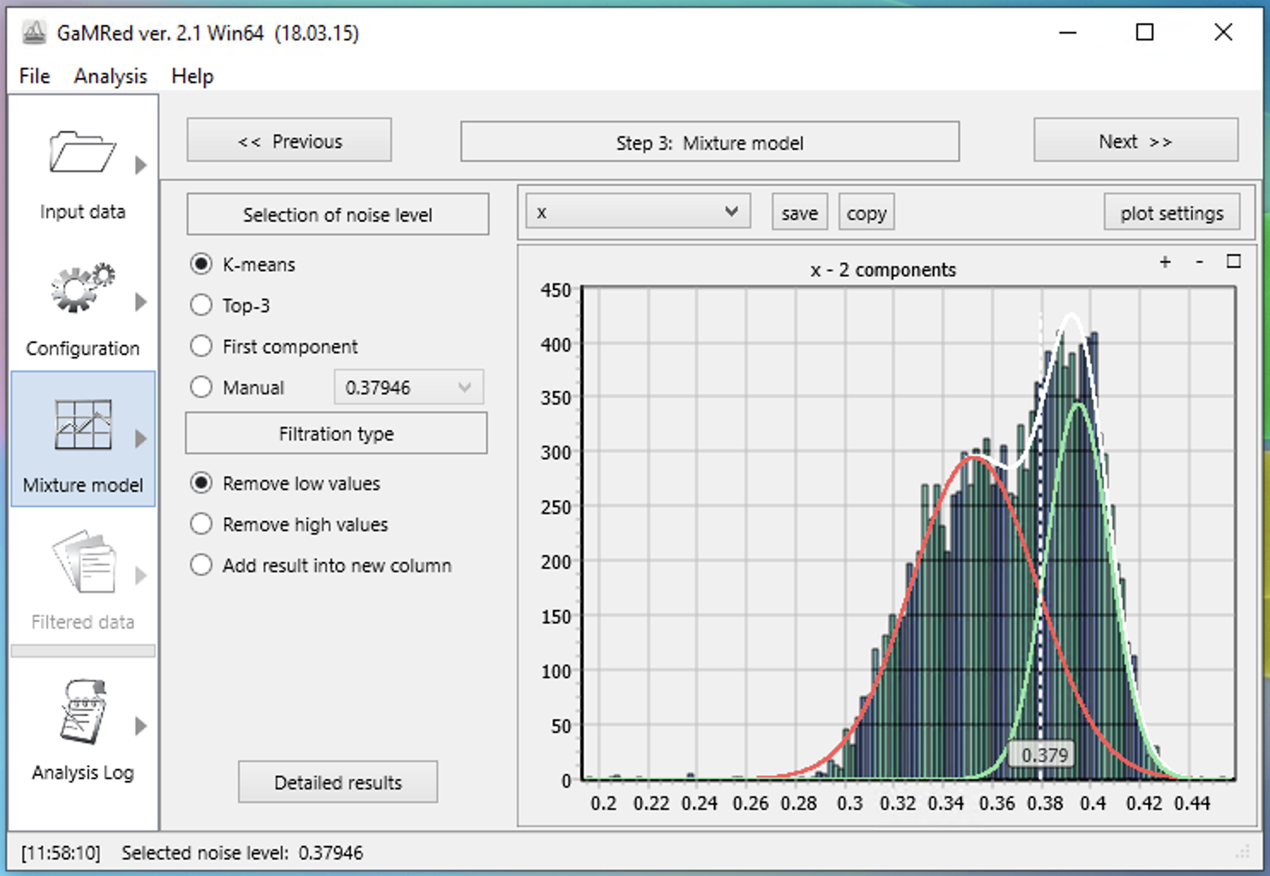
03 - Workflow
Normalization and scaling
Normalize the data (log normalization)
Calculate variances for each gene
Using Gaussian Mixture Models determine the threshold for selecting the genes with highest variance
Scale the data

Slide 7
03 - Workflow
Performing Dimensionality Reduction
Running PCA and ICA
Creation of Elbow Plot based on PCA
Determination of inflection point

Slide 8
03 - Workflow
Clustering
Cluster cells
Dimensionality reduction using UMAP (and tSNE)
Plot UMAP

Slide 9
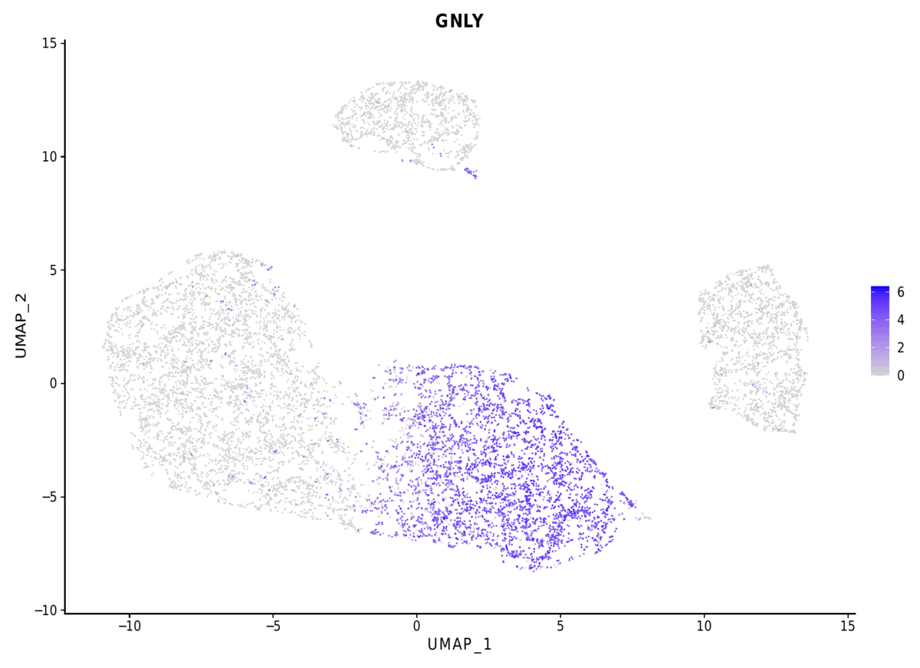
03 - Workflow
Finding biomarkers - TODO
Finding differentially expressed features (cluster biomarkers)
Annotate clusters
Compare the obtained results with the result achieved in original publication

